Slide 1

TPG 2 - Case Study
“"Income and substitution effects and home ownership"
Basic Economics for Sustainable Industrial Engineering (M1 SIE)
October 15th, 2020

Slide 2
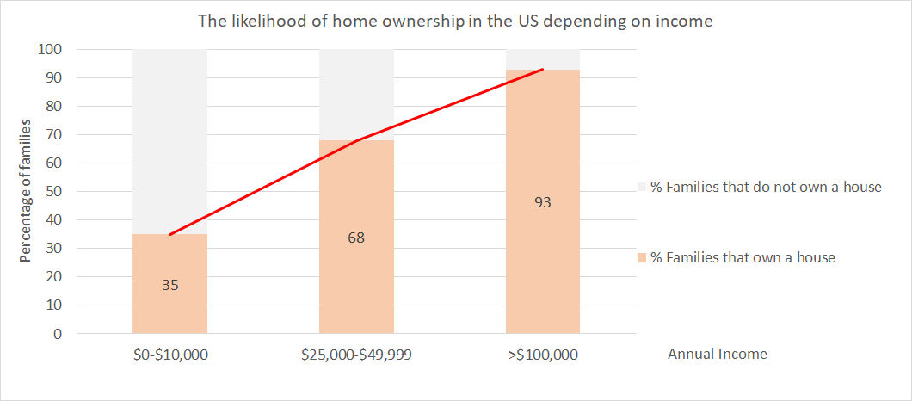
Introduction of the case
The likelihood of home ownership in US increases with income :

Slide 3
The substitution effect
What are you giving up OR gaining when you buy that house?
The income effect
How does your income level impact your purchasing power /your ability to buy the house?
The total effect of a relative price change
on demand for houses
The income effect expresses the effect of a change in your income on your consumption.
The substitution effect describes how consumption is impacted by changing relative prices of goods.
Relative price is the price of a good or service in terms of another. The relative price of a good is also the opportunity cost of buying that good.
Due to this effect, You switch your consumption from one product to another product because the price of at least one of two the products has changed;
Purchasing power is a mix between :
the income effect (a higher income leads to higher purchasing power)
the price effect on your income (decreased prices lead to a higher purchasing power)
Normal good : one whose quantity demanded rises as income rises. For normal goods, the 2 effects work in the SAME direction.
A progressive tax is based on the taxpayer's ability to pay. It imposes a lower tax rate on low-income earners than on those with a higher income. This is usually achieved by creating tax brackets that group taxpayers by income ranges.

Slide 4
How do these concepts come into play in the following scenario?
Tax rate | Taxable income bracket
10% | $0 to $9,875
12% | $9,876 to $40,125
22% | $40,126 to $85,525
24% | $85,526 to $163,300
32% | $163,301 to $207,350
35% | $207,351 to $518,400
37% | $518,401 or more
House price | Years of mortgage | Annual mortgage payment | Annual interest of 3.7% on payment
$226,800 | 10 | $22,680 | $839
Household 1
Household 1
Taxable income:
$ 32,000
Taxable income:
$ 31,161
without buying a house
with buying a house
$ 32,000
$ 32,000
Mortgage interest
Not taxed. Tax savings
of 839*0.12 = $ 101
$ 31,161
This much gets taxed at 12%
This much gets taxed at 12%
$ 9,875
$ 9,875
This much gets taxed at 10%
This much gets taxed at 10%
$ 0
$ 0

Slide 5
Tax rate | Taxable income bracket
10% | $0 to $9,875
12% | $9,876 to $40,125
22% | $40,126 to $85,525
24% | $85,526 to $163,300
32% | $163,301 to $207,350
35% | $207,351 to $518,400
37% | $518,401 or more
Household 2
Household 2
Taxable income:
$ 260,000
Taxable income:
$ 259,161
without buying a house
with buying a house
Mortgage interest
$ 260,000
$ 260,000
Not taxed. Tax savings of 839*0.35 = $ 294
This much gets taxed at 35%
$ 259,161
This much gets taxed at 35%
$ 207,350
$ 207,350
This much gets taxed at 32%
This much gets taxed at 32%
$ 163,300
$ 163,300
This much gets taxed at 24%
This much gets taxed at 24%
$ 85,525
$ 85,525
This much gets taxed at 22%
This much gets taxed at 22%
$ 40,125
$ 40,125
$ 294 saved for
high income household B
vs
$ 101 saved for
lower income household A
This much gets taxed at 12%
This much gets taxed at 12%
$ 9,875
This much gets taxed at 10%
$ 9,875
This much gets taxed at 10%
$ 0
$ 0

Slide 6
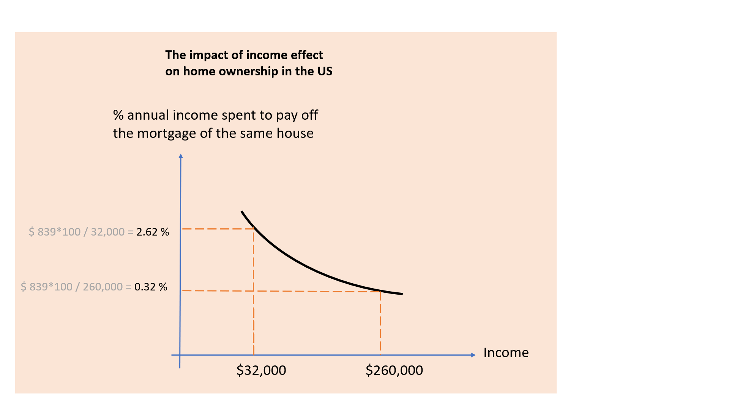
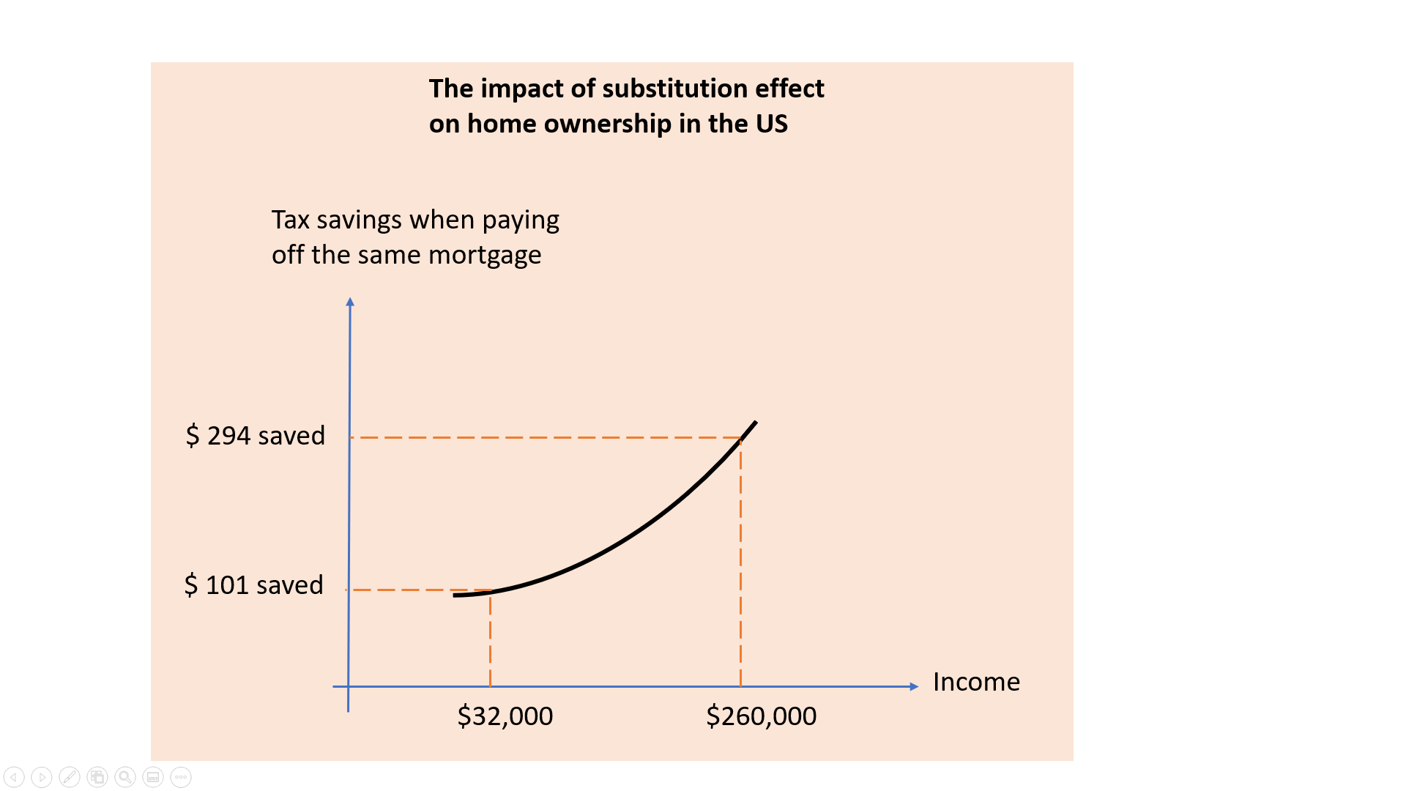
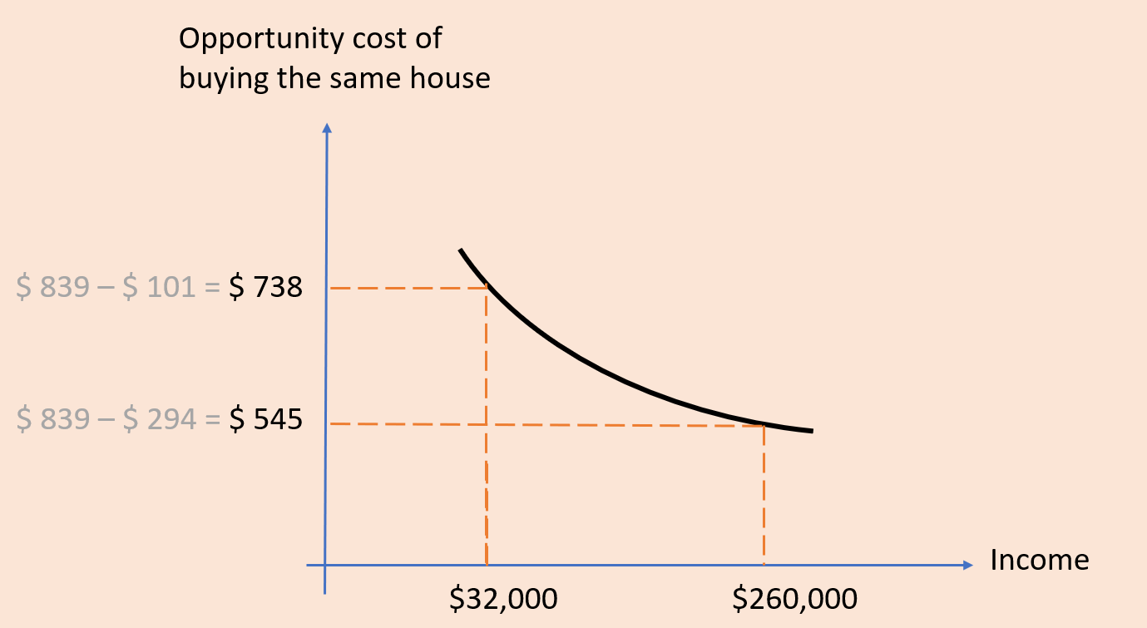
INCOME EFFECT
SUBSTITUTION EFFECT
Rate of tax increases with income, and higher income family/individuals can disproportionately reduce the amount of mortgage interest which causes a reduction of the relative price of the house.
+
Marginal effort for household ownership is decreasing with the income: the higher the income, the more the incitation to pay a mortgage, because the mortgage is decreasing marginally with the income.
=
Likelihood of home ownership
The TOTAL EFFECT
Income

